Slide 1
Subtraction Story Problems
By the ECA First Graders
October 2012
This is the culminating activity to our story problem process. See the steps involved and be “wowed” at the end of this presentation!

Slide 2
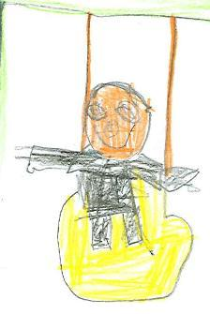
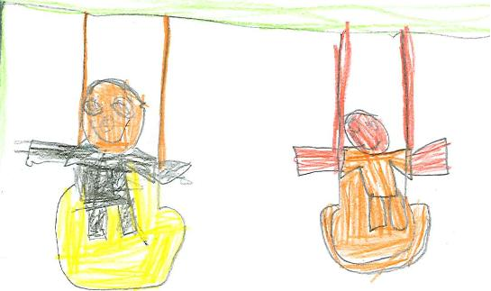
Charlie 3boy are playing then 2 boys go how many boys are still playing?
Answer
1 boy
Created by the ECA First Graders @ www.ecafirstgrade.weebly.com

Slide 3
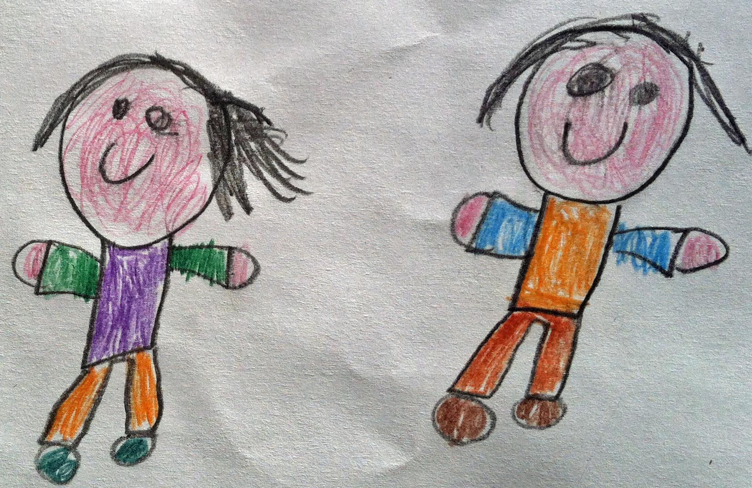
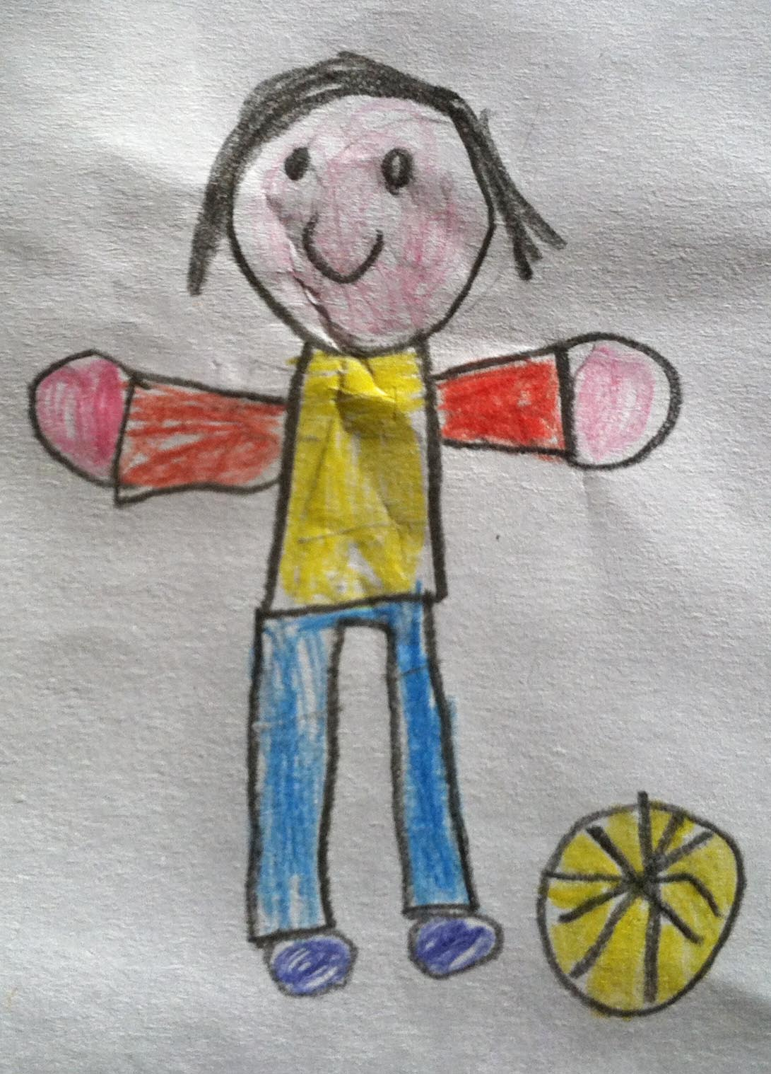
3 girls are playing. 1girl goes home. Now how many girls still playing? Laura
Answer
2 girls
Created by the ECA First Graders @ www.ecafirstgrade.weebly.com

Slide 4
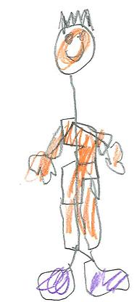
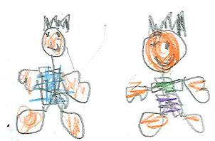
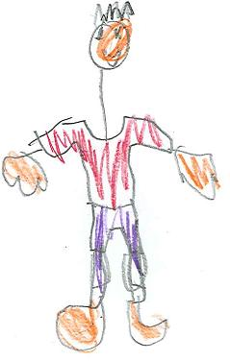
5 children were walking in the mall. Then 4
Children went out of the mall. Now how many
Children are still in the mall? Arjit
Answer
1 child
Created by the ECA First Graders @ www.ecafirstgrade.weebly.com

Slide 5
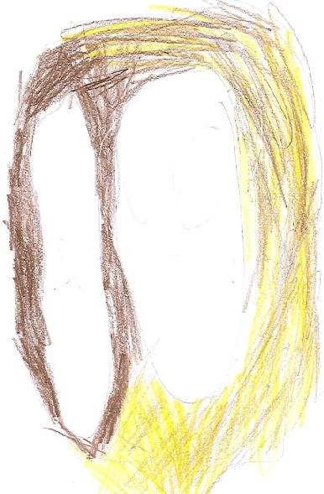
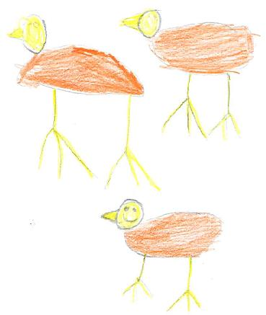
5 eggs were laying in the nest. Then 3 eggs hatched. Now how many eggs are still in the nest? Tyler
Answer
2 eggs
Created by the ECA First Graders @ www.ecafirstgrade.weebly.com

Slide 6
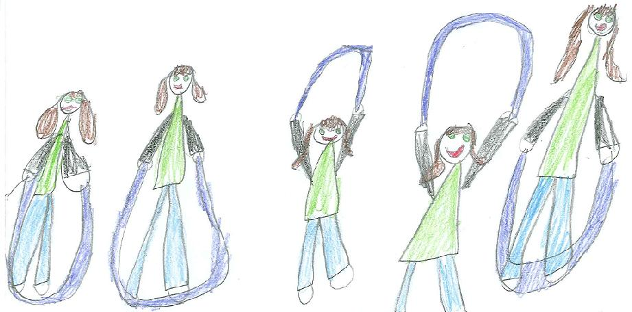
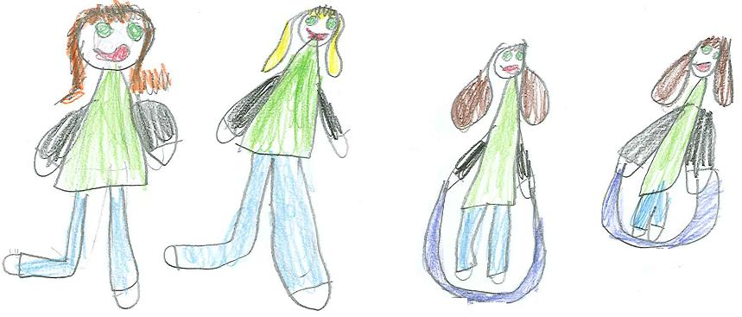
9 girls were jumping. T hen 4 girls skipped away. Now how many girls are still jumping? Grace
Answer
5 girls
Created by the ECA First Graders @ www.ecafirstgrade.weebly.com

Slide 7
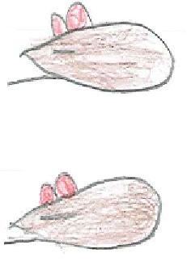
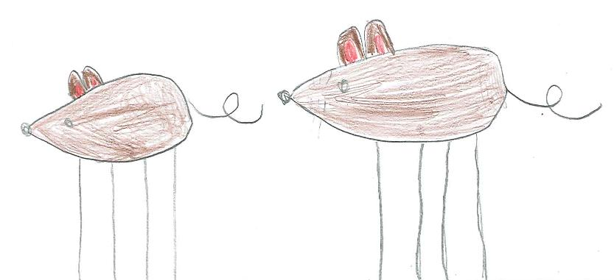
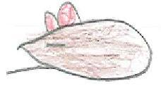
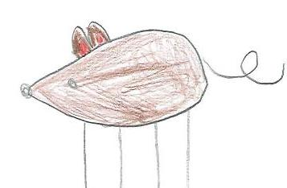
I.J.
10 mice were napping in a hole. Then 5 mice woke up. Now how many mice are napping?
Answer
5 mice
Created by the ECA First Graders @ www.ecafirstgrade.weebly.com

Slide 8
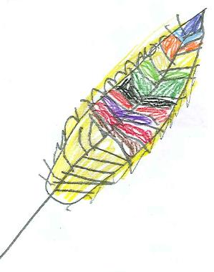
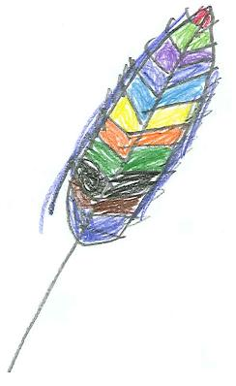
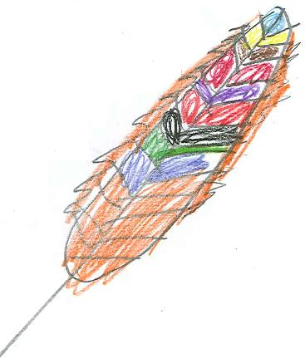
Gabriella
6 feathers floated to the ground. then 3 feathers floated away. now how many feathers are still on the ground?
Answer
3 feathers
Created by the ECA First Graders @ www.ecafirstgrade.weebly.com

Slide 9
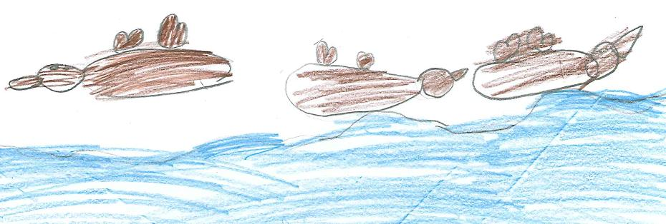
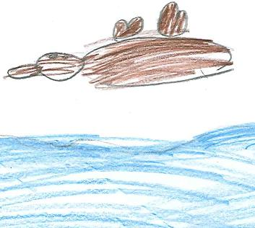
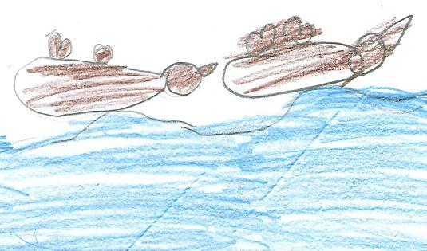
9 birds are swimming . 8 birds fly a way. Now how many birds are still swimming? Caterina
Answer
1 bird
Created by the ECA First Graders @ www.ecafirstgrade.weebly.com

Slide 10
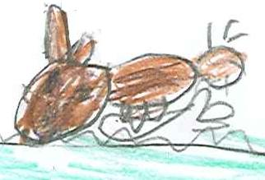
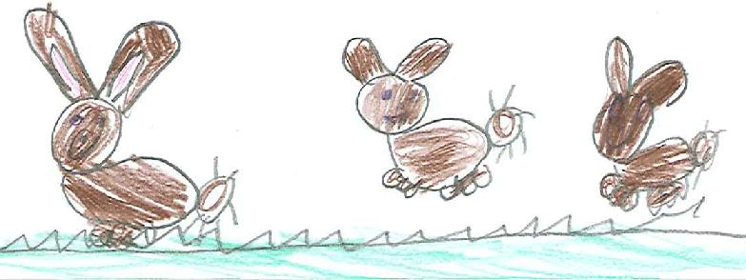
9 bunnies are hopping . then 8 bunnies start eating. Now how many bunnies are still hopping? A. R.
Answer
1 bunny
Created by the ECA First Graders @ www.ecafirstgrade.weebly.com

Slide 11
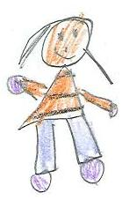
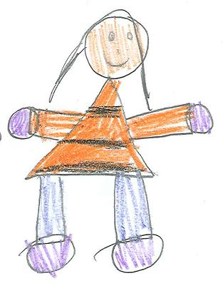
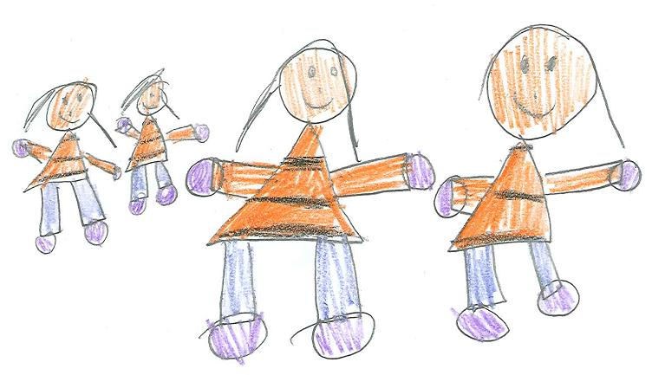
7 girl are jumping.
6 girls stop to eat ice cream.
Now how many girls are jumping?
Ava w
Answer
1 girl
Created by the ECA First Graders @ www.ecafirstgrade.weebly.com

Slide 12
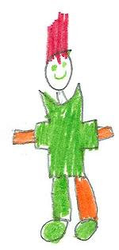
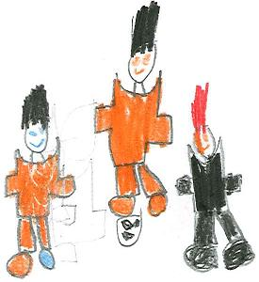
Dylan
4 boy are playing soccer.Then 3 boy walk away. Now how many boys are still playing?
Answer
1 boy
Created by the ECA First Graders @ www.ecafirstgrade.weebly.com

Slide 13
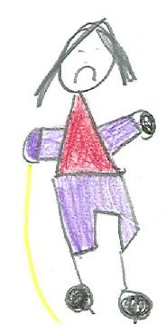
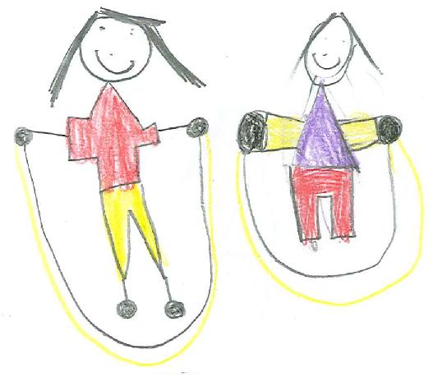
8 girls are jumping rope.
Then 1 girl walks away
Now how many
Girls are still jumping rope?
Dakota
Answer
7 girls
Created by the ECA First Graders @ www.ecafirstgrade.weebly.com

Slide 14
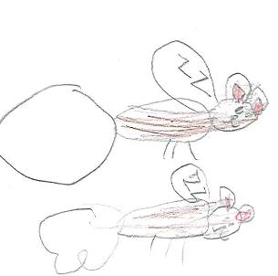
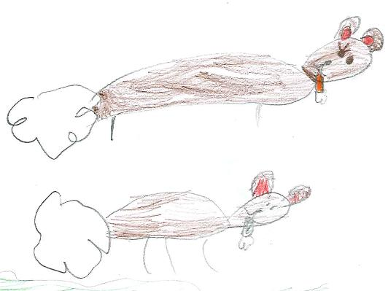
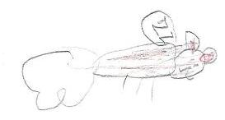
5 bunnies are eating carrots.
3 bunnies go to sleep.
Now how many
Bunnies still eating carrots?
Kasey
Answer
2 bunnies
Created by the ECA First Graders @ www.ecafirstgrade.weebly.com

Slide 15
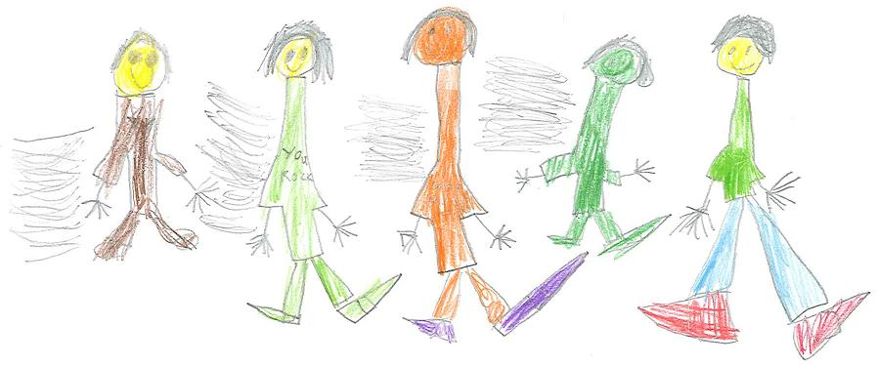
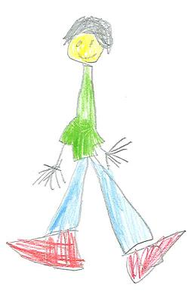
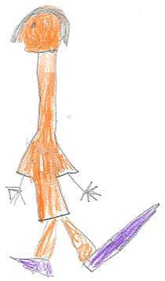
8 boys are racing .7 boys stop to get water. Now how many Boys are still racing? Marcelo
Answer
1 boy
Created by the ECA First Graders @ www.ecafirstgrade.weebly.com

Slide 16
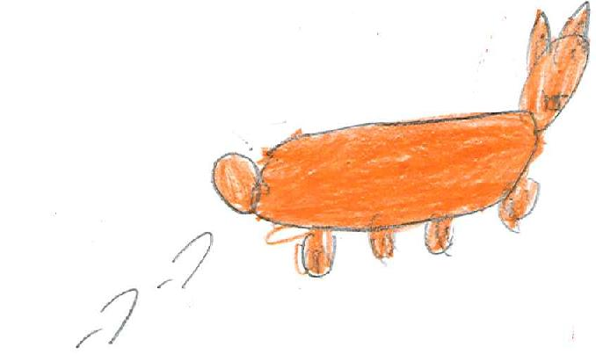
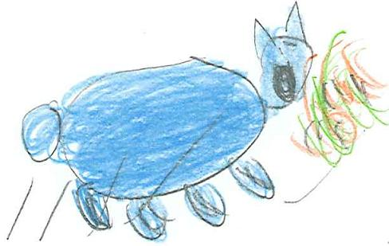
5 bunnies are hopping 2 bunnies stop to eat Now how many bunnie are stil hopping? K.U.
Answer
3 bunnies
Created by the ECA First Graders @ www.ecafirstgrade.weebly.com

Slide 17
The Process
Created by the ECA First Graders @ www.ecafirsgrade.weebly.com

Slide 18
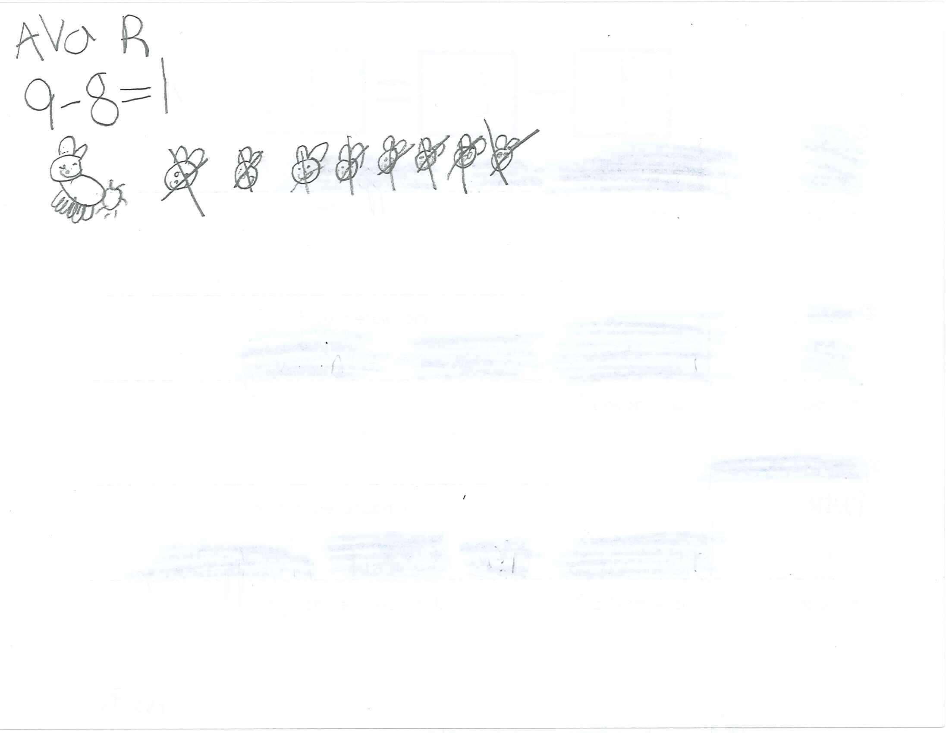
First the children drew a picture and wrote a number sentence.
Created by the ECA First Graders @ www.ecafirsgrade.weebly.com

Slide 19
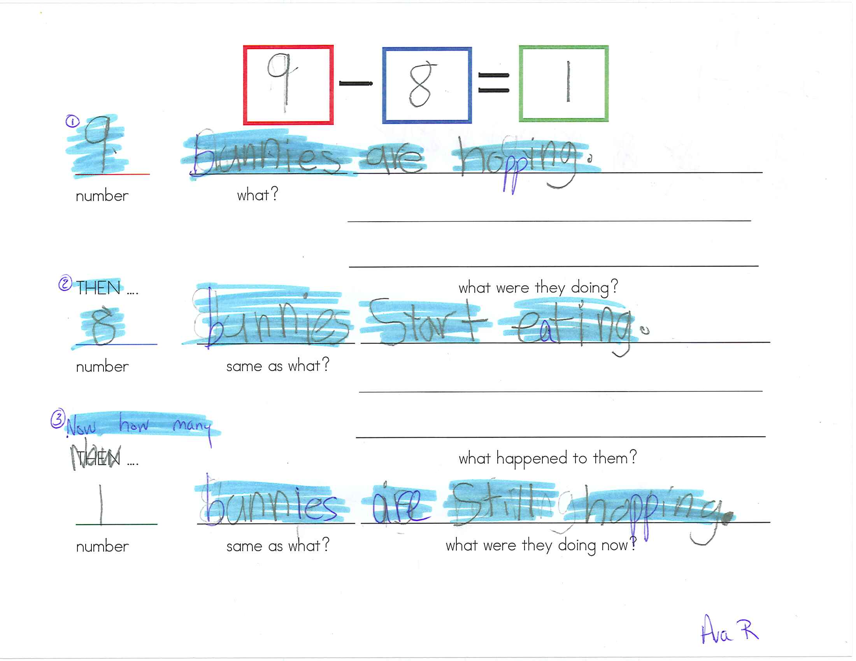
Then they used a form to create a story problem.
Created by the ECA First Graders @ www.ecafirsgrade.weebly.com

Slide 20
They wrote a 2nd draft and then typed it into word.
Created by the ECA First Graders @ www.ecafirsgrade.weebly.com

Slide 21
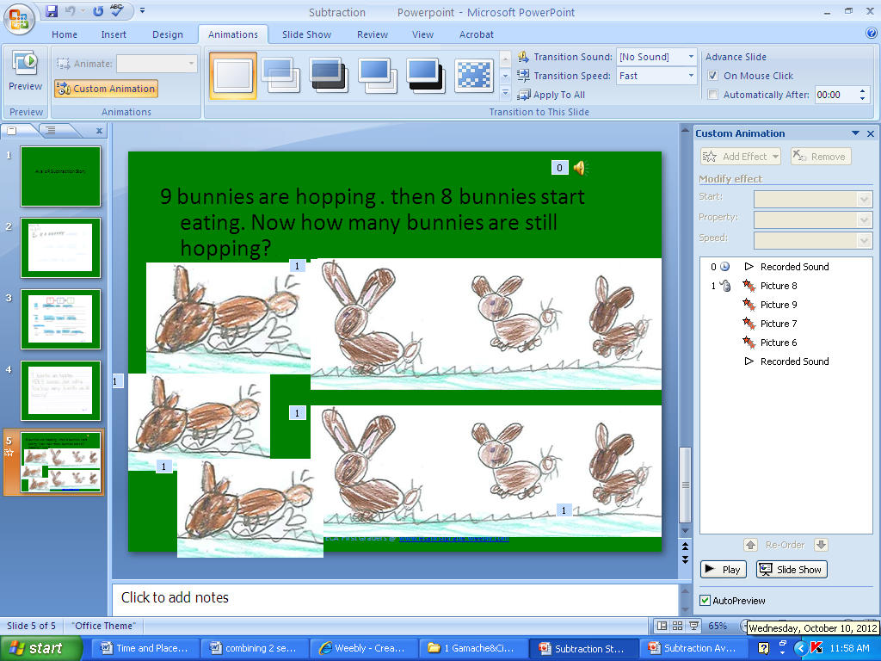
After that they drew pictures to go with their story. During tech they each created a 5 page ppt, inserting pictures to show all the steps listed above.
Created by the ECA First Graders @ www.ecafirsgrade.weebly.com

Slide 22
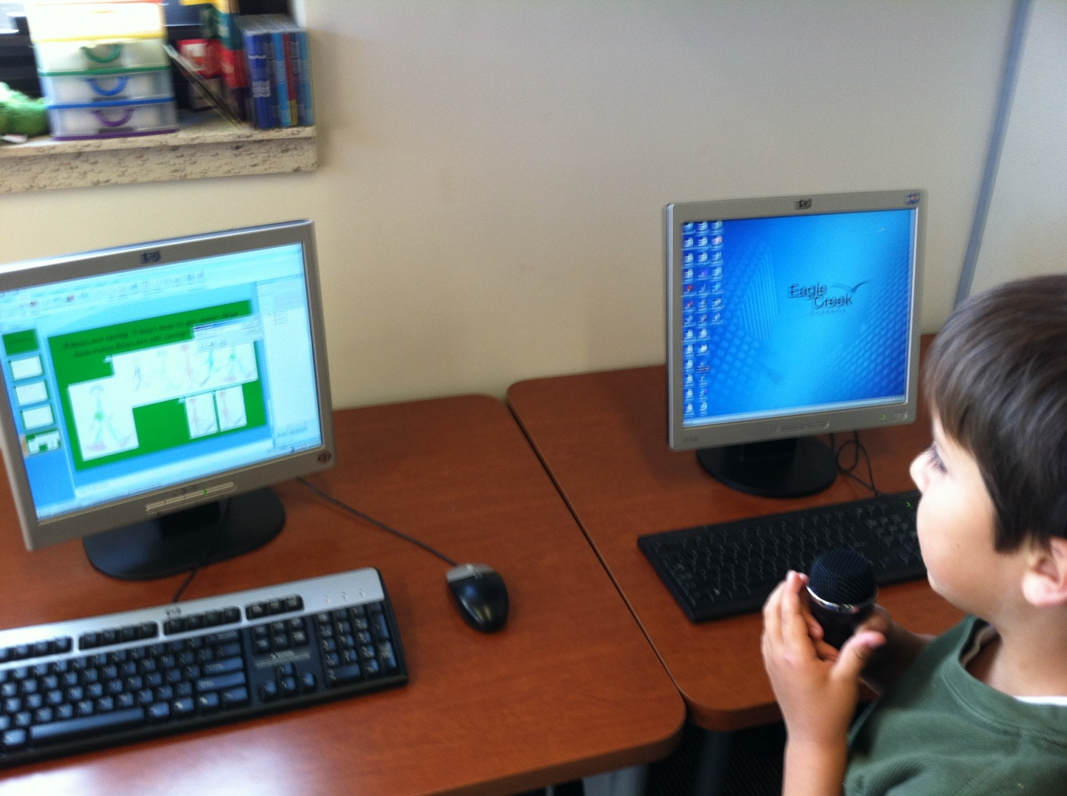
Finally they worked in groups of 2 to insert the final pictures, animate and record sound. They are very proud of their work!
Created by the ECA First Graders @ www.ecafirsgrade.weebly.com

Slide 23
The End
Created by the ECA First Graders @ www.ecafirstgrade.weebly.com

